Slide 1
Daily Bible
Gloria Kim

Slide 2
01
WHY I MADE THE APP

Slide 3
—Psalm 1:1-2
“Blessed is the one whose delight is
in the law of the Lord and…meditates on his law day and night.”

Slide 4
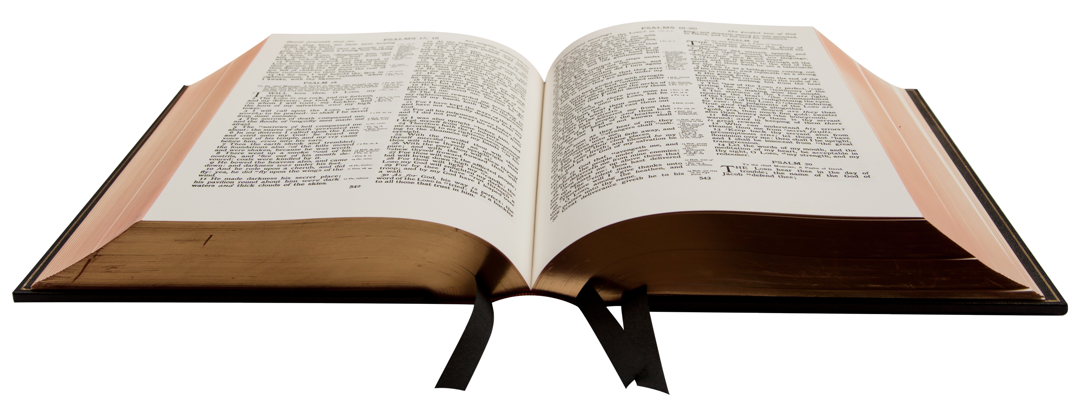
1,200 PAGES?!
However, reading the Bible may be overwhelming…
In fact, the Bible has over 1,200 pages to read!

Slide 5
HOW OFTEN CHRISTIANS READ?
32%
Everyday
68%
Not Everyday (12% Rarely/Never)

Slide 6
02
WHAT I ADDED IN THE APP

Slide 7
ACHIEVETHE BIG GOAL!
Many business magazines recommend to…
Set a realistic goal
Set a measurable goal
Create an action plan
Give a reward to yourself
Notes:
Reference: https://www.inc.com/marcel-schwantes/want-to-reach-your-big-goals-make-sure-to-do-these-8-things.html

Slide 8
REALISTIC GOALS
MESURABLE GOALS
REWARDS
ACTION PLANS
THREE READING PLANS
COUNTING DAYS
REWARD PAGE
DAILY ALARM

Slide 9
03
HOW I MADE THE APP
You could enter a subtitle here if you need it

Slide 10





01
02
03
DESIGN Adobe XD
PUBLICATION Google AppStore
FUNCTION Android Studio

Slide 11
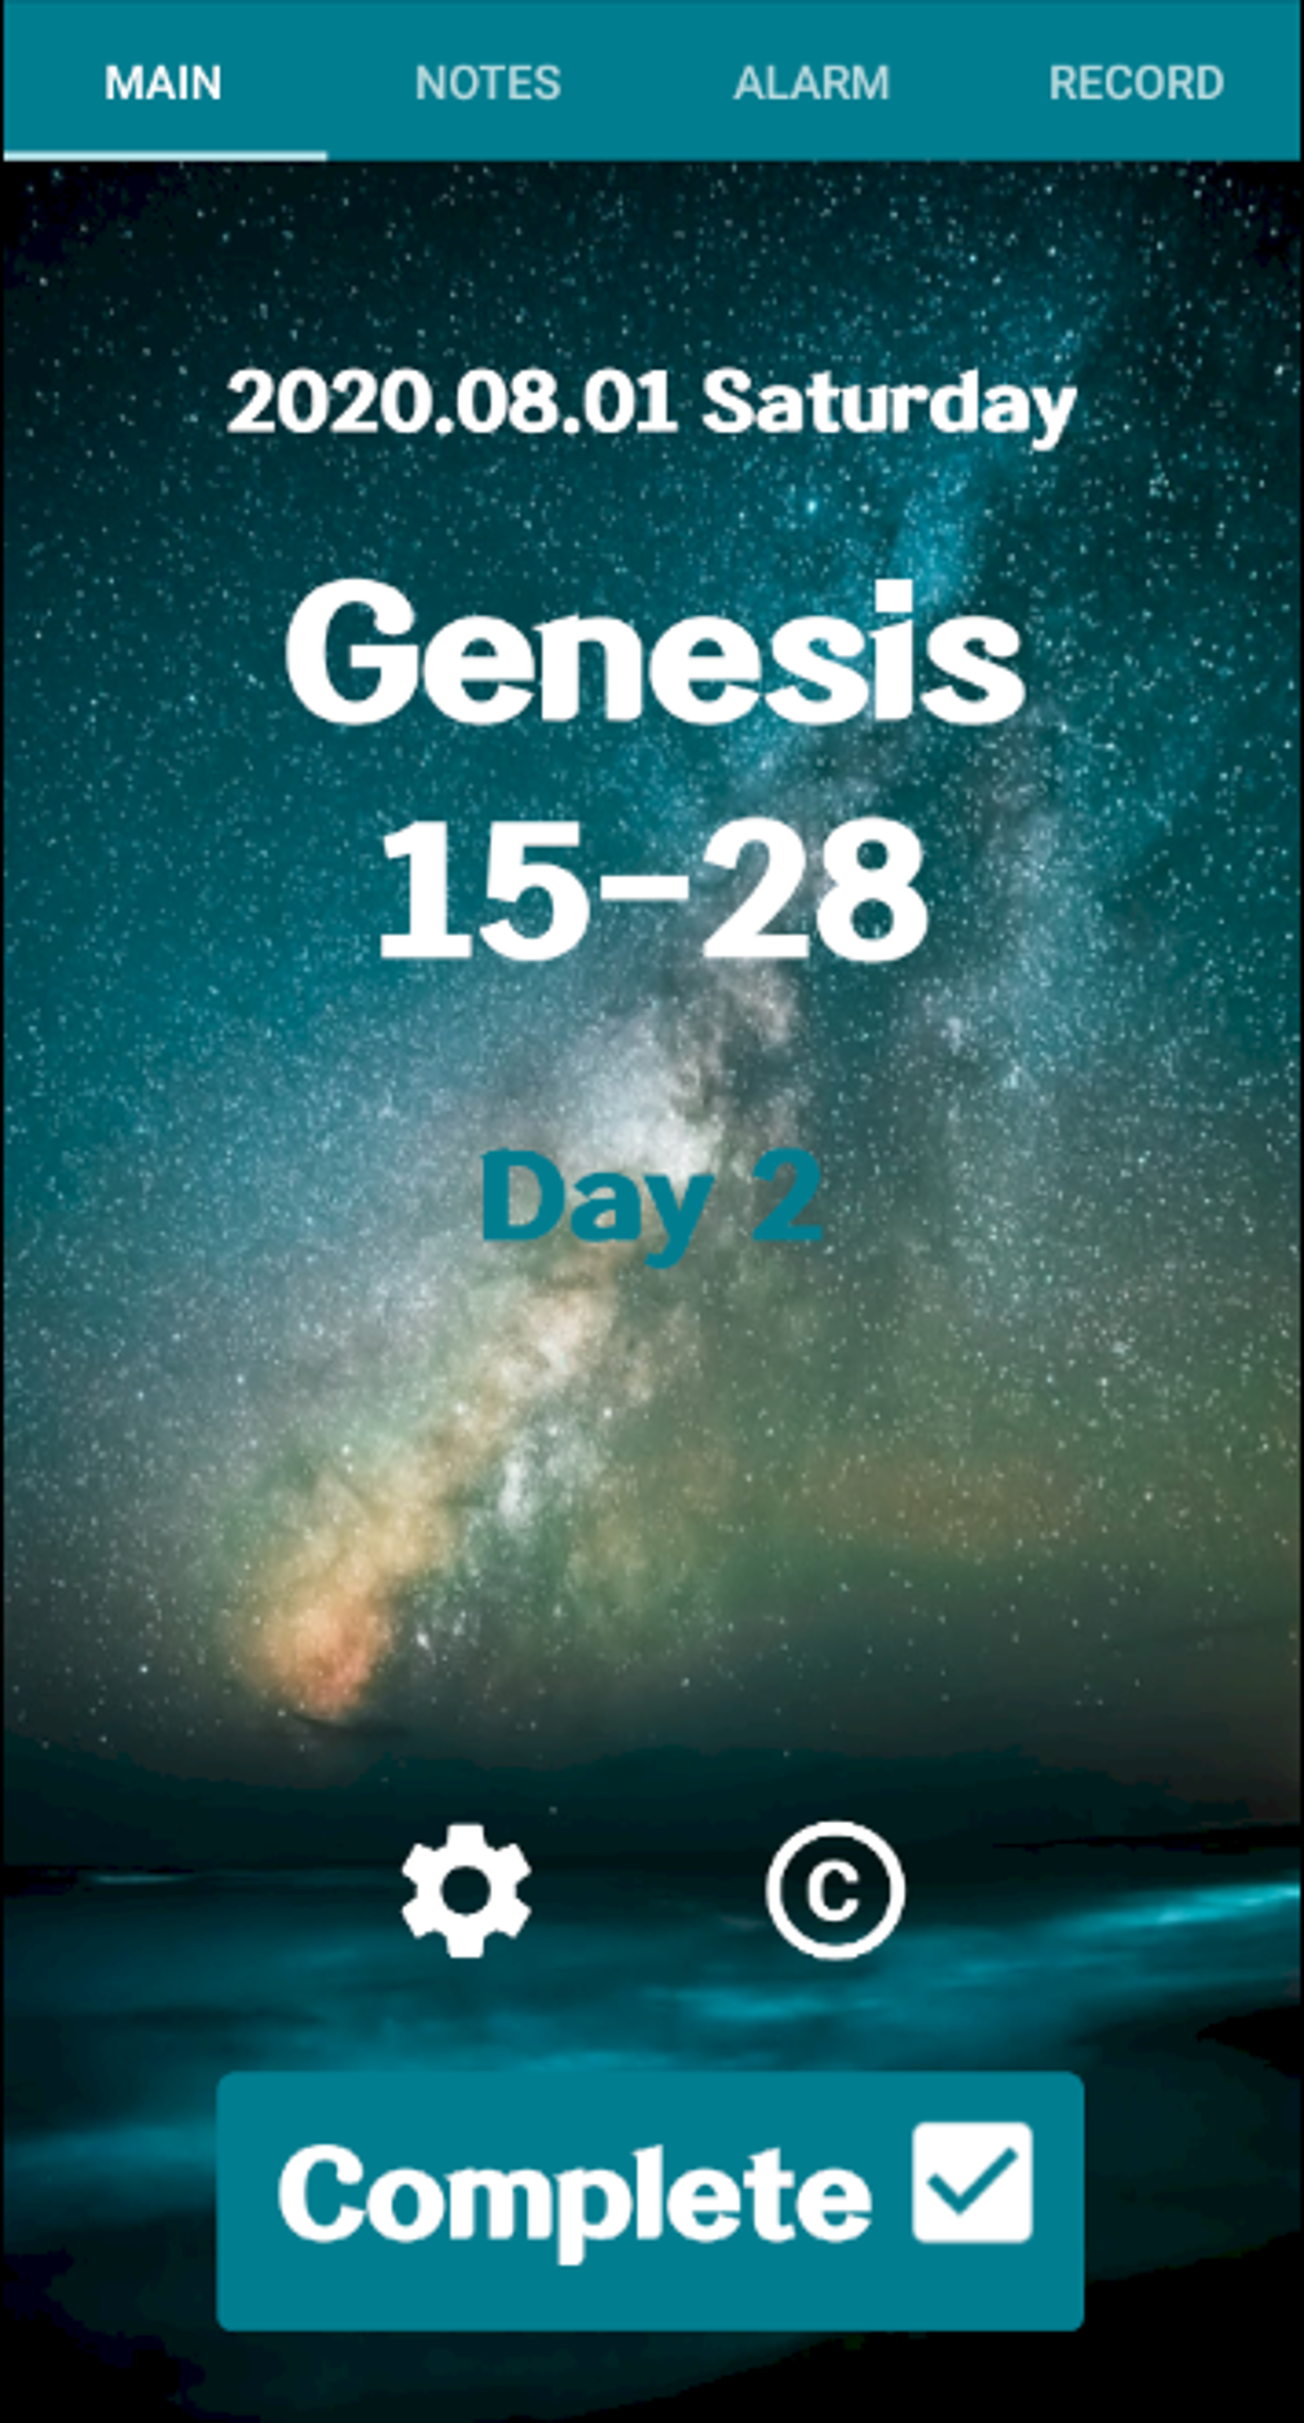
MAIN PAGE
Functions:
Today’s Date Today’s Bible Verse Number of Reading Days Complete Button Setting Credit

Slide 12
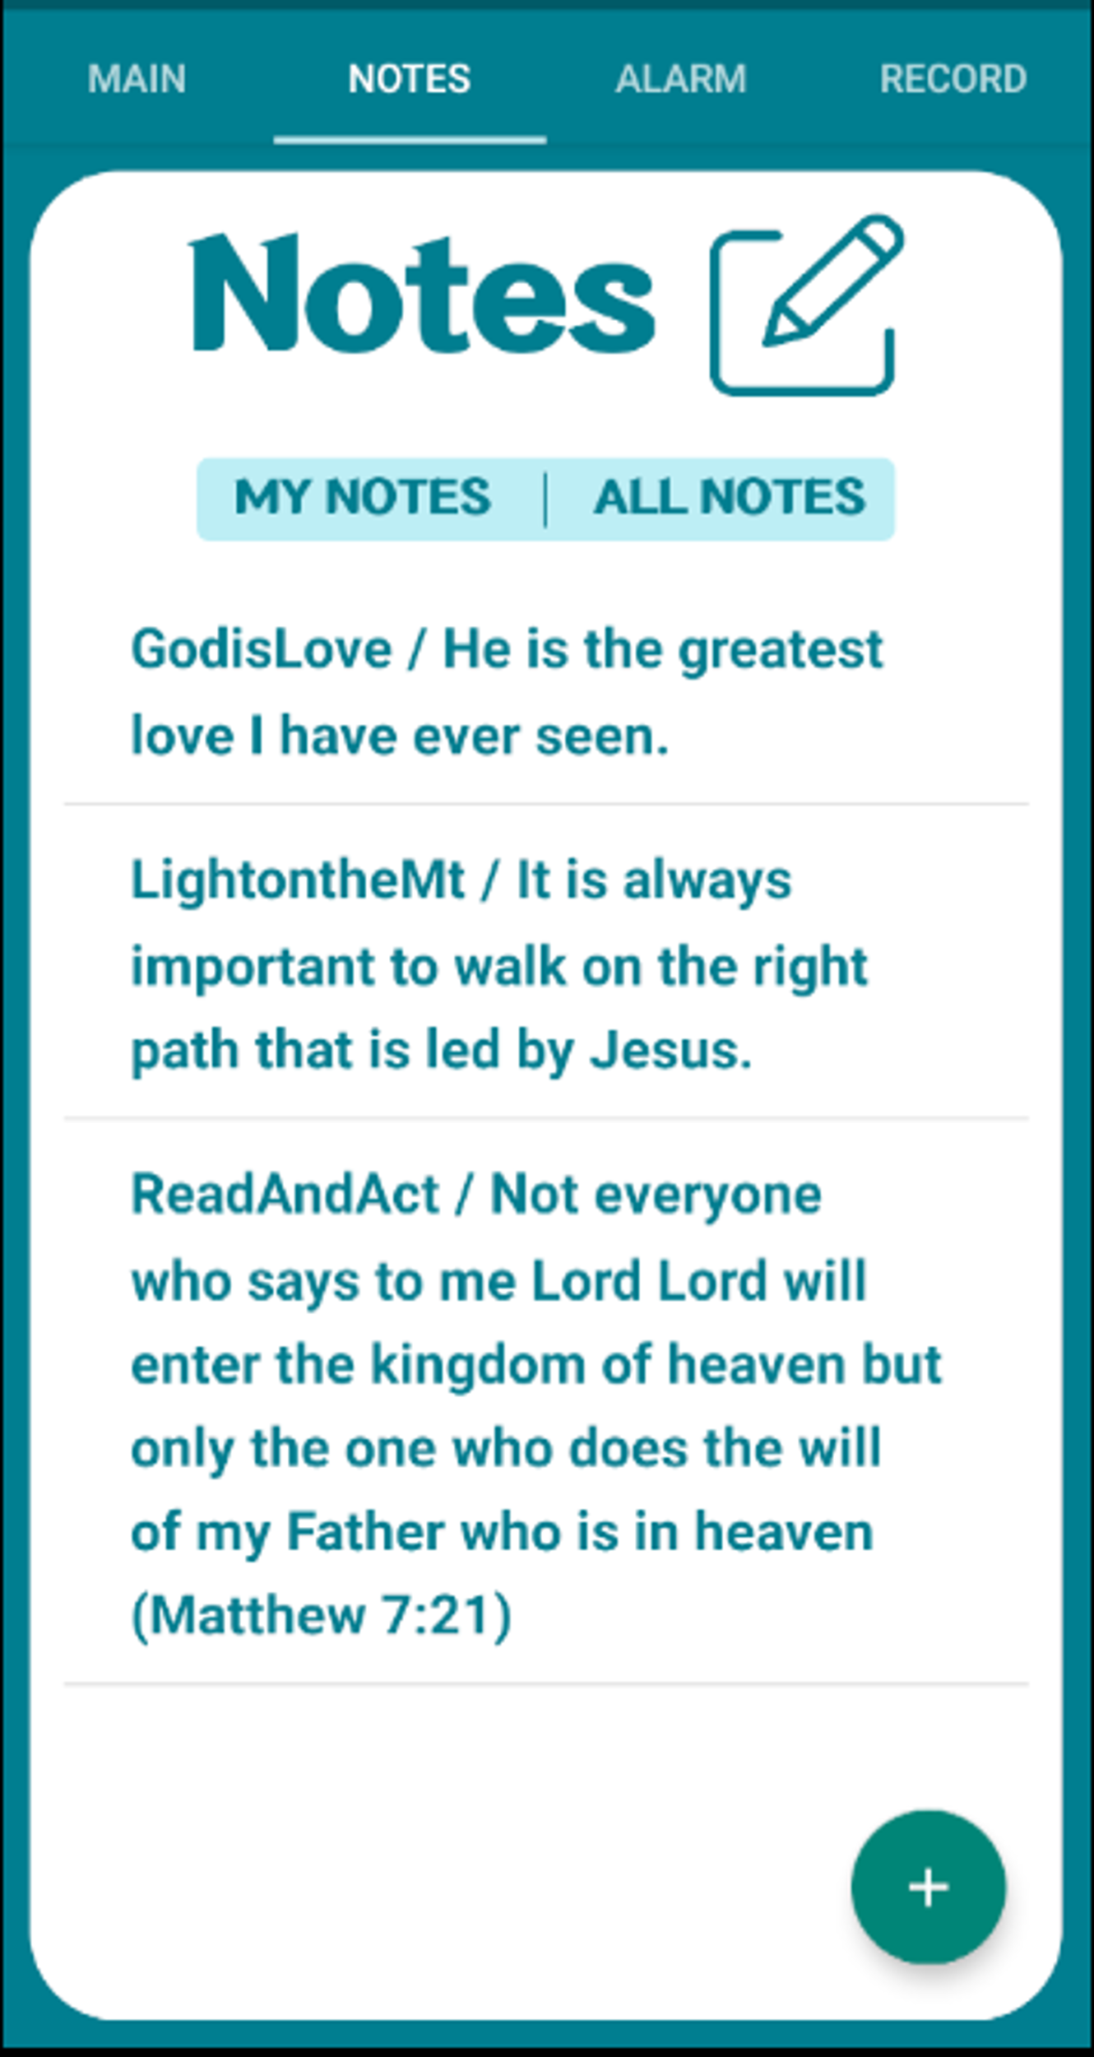
NOTE PAGE
Functions:
Private Note (Create, Edit, Delete) Public Note (Create) Floating Button

Slide 13
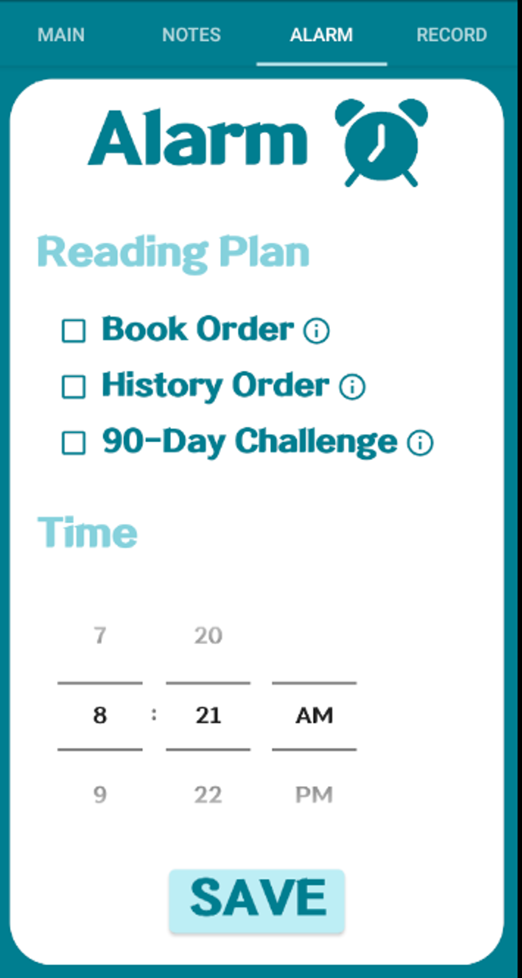
ALARM PAGE
Functions:
ACTION PLAN!
Reading Plan (90-Day, Bible Order, History Order) Reading Plan Info Alarm Time
REALISTIC GOAL!
MESURABLE GOAL!

Slide 14
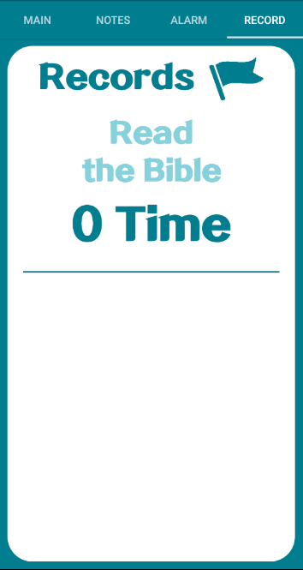
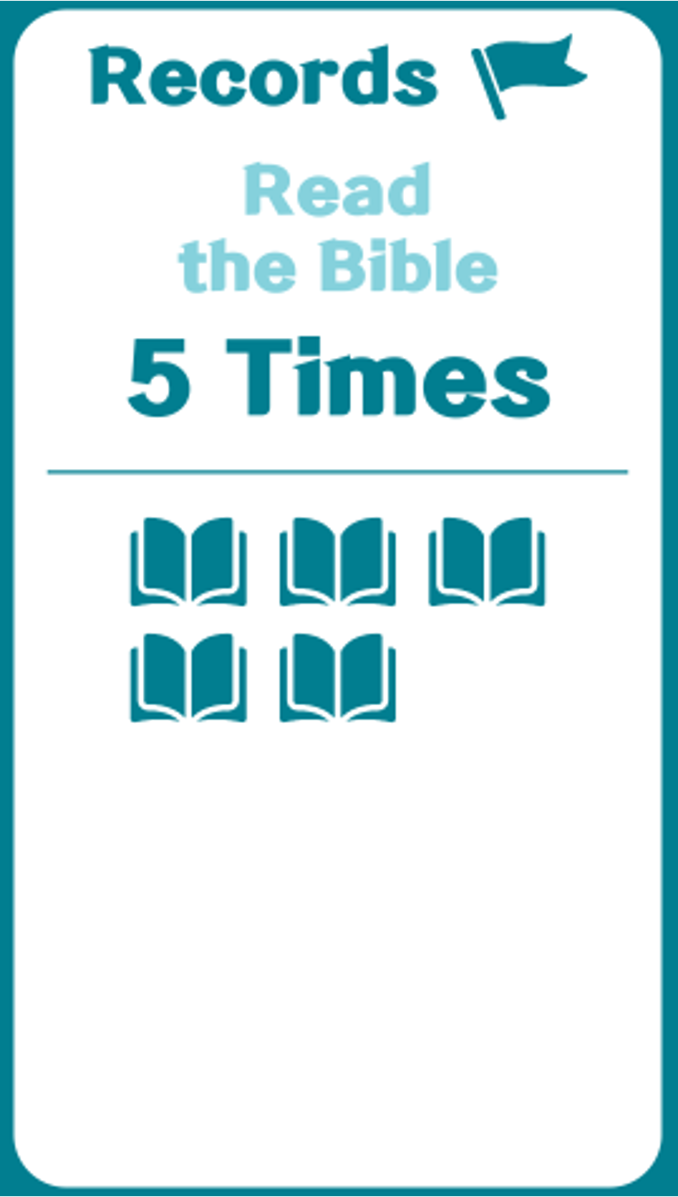
REWARD PAGE
Functions:
REWARD!
Number of Completion Bible Icons

Slide 15



LIVE DEMO
Notes:
Firebase: https://console.firebase.google.com/u/1/project/daily-bible-with-alarm/database/daily-bible-with-alarm/data

Slide 16
“Not everyone who says to me, ‘Lord, Lord,’ will enter the kingdom of heaven, but only the one who does the will of my Father who is in heaven.”
—Matthew 7:21
Notes:
Future work

Slide 17
THANKS!
Any Questions? ☺

